Slide 1





Current
Journey
SCENARIO:
Mr. and Mrs. Joe want to arrange their banking transactions to gain comparison reports between original budget vs actual expenses.
GOALS & EXPECTATIONS:
Mr. & Mrs. Joe want to perform budgeting without going through too much pain.
Mr. & Mrs. Joe want to prevent errors in calculations.
Mr. & Mrs. Joe want to do budgeting following consistent intervals.
After 2 hours:
Mr. Joe: You know what, let’s do remaining work including calculations and evaluating reports tomorrow.
Mrs. Joe: Yes sure. I just hope somebody else does this for us. By the way tomorrow never comes.
After 1 hour
Mrs. Joe: We just did couple of months, we have several more months to look into. Why we don’t do it more regularly. Its just too much work now.
Mr. Joe: We have more bank accounts to look into. I also have to apply some calculations to get some numbers. Its so frustrating.
Mr. Joe: Let’s do budgeting today. I am opening bank site to go over transactions.
Mrs. Joe: Ok I will help you, but you have to find a better way for this. Its so tiring.
Mr. Joe: Let’s try a faster way this time. You just scan through transactions and I keep noting them down and will mark their category.
Mrs. Joe: I am not sure if it is any different than before. But let’s just start, I really want to get over this.
Tomorrow never comes.
1
4
2
5
3
Opportunity:
- Manual budgeting is so laborious that it requires an extra effort to setup the mood, sit down and start it.
Opportunity:
Manual budgeting is so frustrating that it becomes difficult to be regular.
Manual budgeting has errors, require time to doublecheck/ fix errors.
Opportunity:
- Many times budgeting remains partial, planning remains partial, retrospection remains partial.

Slide 2

Michael | Likes to get a grip on his budget Calculative person
40 ish IT professional | It is painstaking for him to keep a check on his budget Looking for automated solutions/apps to play with. (More specific pain points, like do not want to spend too much on weekends?)

Slide 3
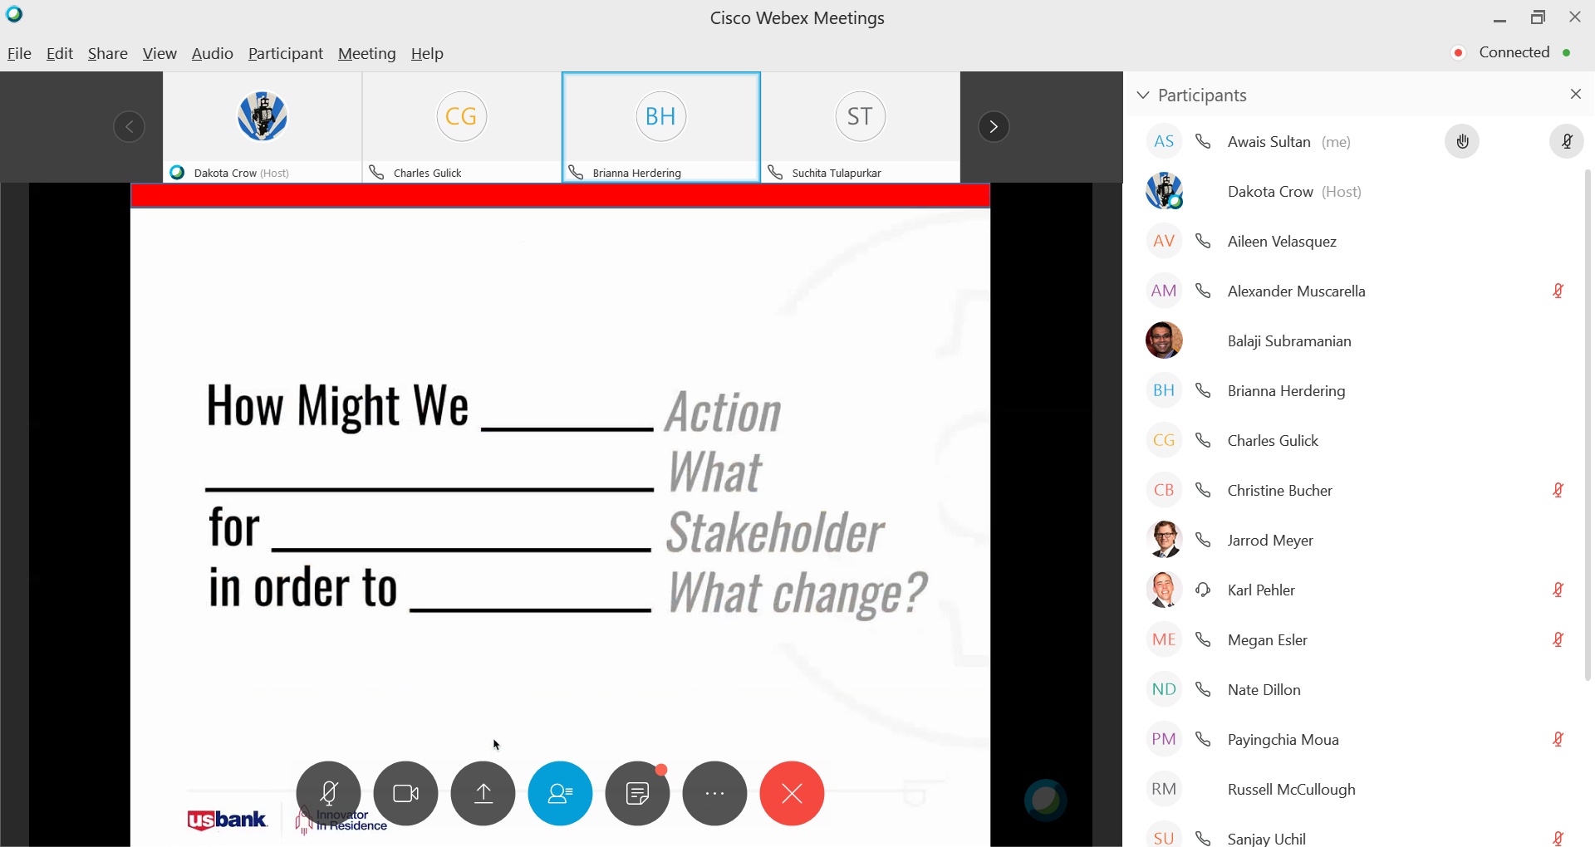
How Might we sort out money spent for outing vs planned for US Bank account customer in order to manage his budget for outing category.

Slide 4
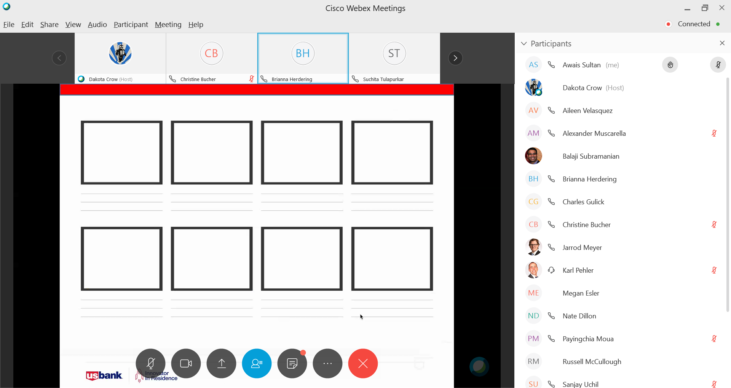

Slide 5
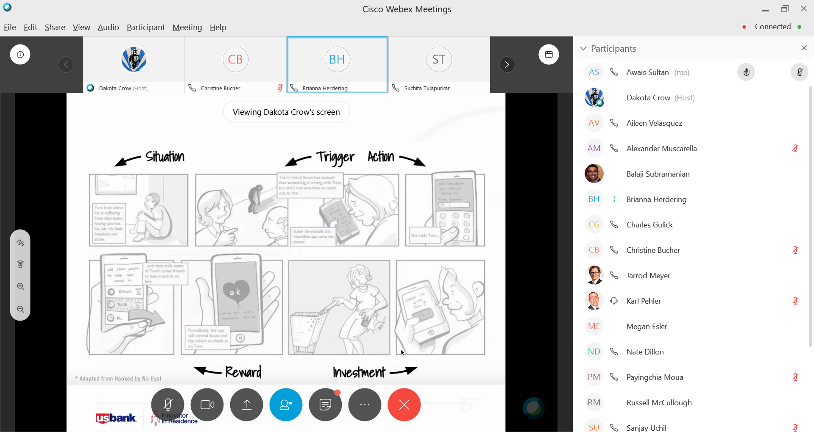

Slide 6
Oh my God we spent too much on outing. We are about 600 dollars over. We set 200 dollars for this.
(Add pictures)
How can we stay within budget if we don’t even know where our money was spent.
Let us see where we spent on outing.
We didn’t even record our trip to six flags.
There are couple of outings we never noticed, how much extra we spent on them.
Now I can do budget on demand. Everything is recorded. I can see how I am performing vs what I planned.
Customer bought a budgeting app.
This app is not free, but I am ok to pay a little bit money on these apps.
Let’s see if we can find an app to do budget for us

Slide 7
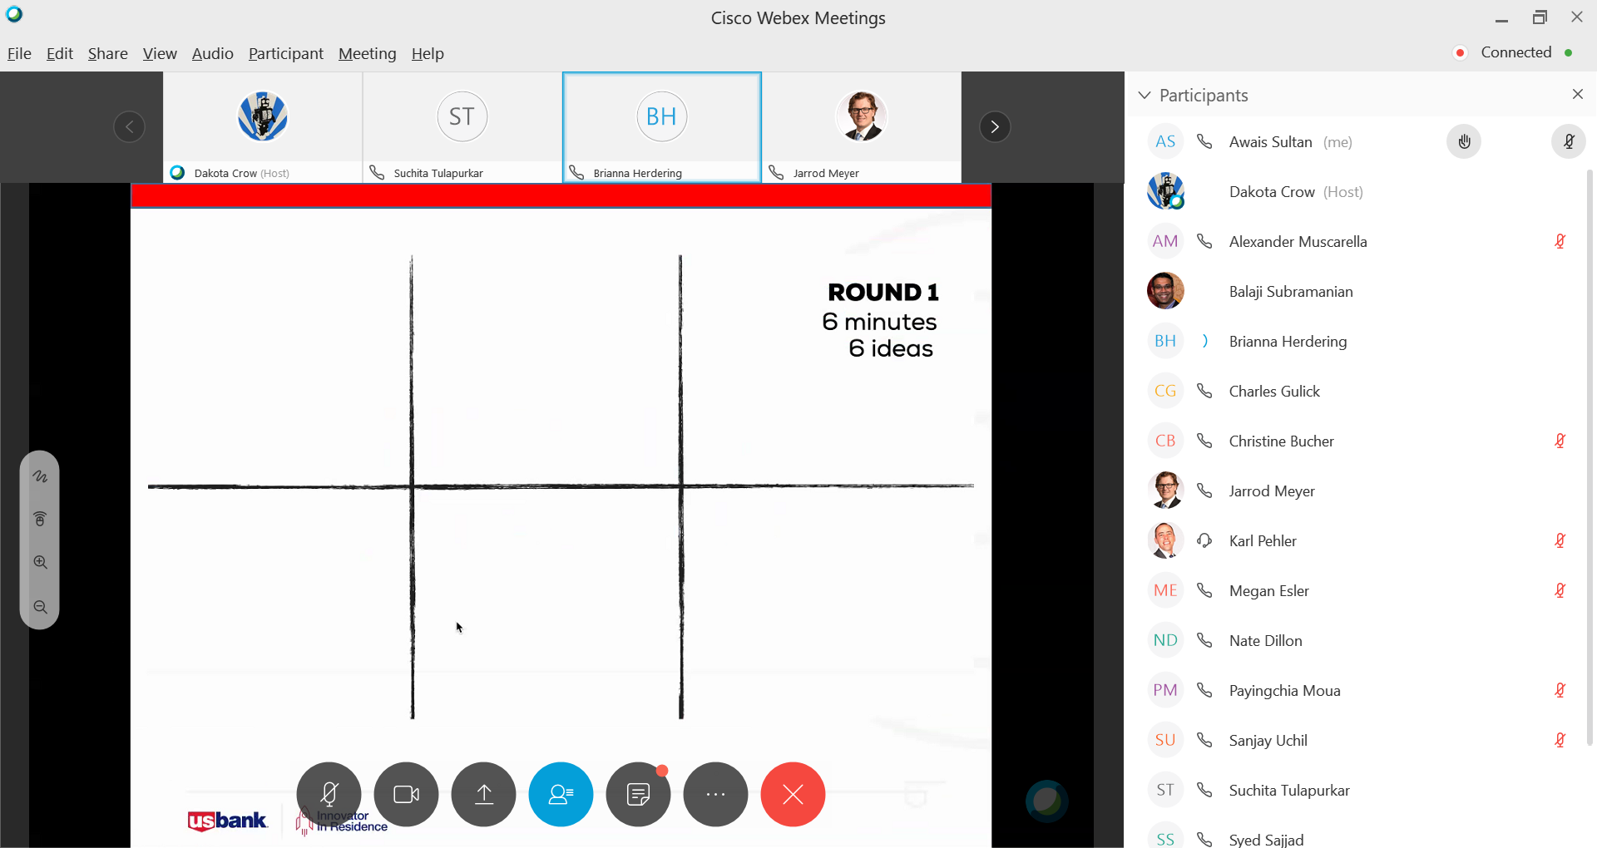

Slide 8
Using Spread sheets to do budget (Add drawings/pictures?) | Provide online/over-phone consultancy services for accounting. Connect to experts. | Hire a personal accountant to prevent leaks and handle taxes.
Only automate budgeting and for other accounting functions, provide suggestions and connect to consultancy numbers. | Automate accounting functions including budget, tax, loans, investments audit, investments coaching (link to a service) through an app. | Offer accounting functions including budget, tax, loans, investments audit, investments coaching (link to a service) on US Bank accounts site.

Slide 9
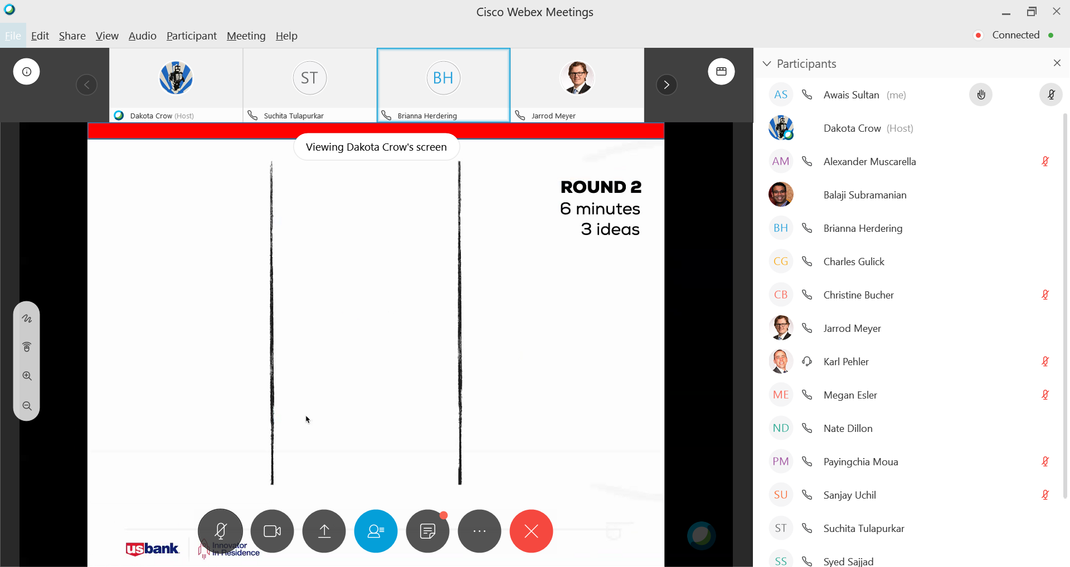

Slide 10
Customers login to website. They see a link for Personal Accountant They also see sub-links under Personal Accountant like Tax, Budget, Investments.. Customer goes to budget and see that how transactions are already placed under various budget categories Customer can see charts showing how much he spent on different categories Customer can create a custom report Customer an setup thresholds for categories He can adjust transactions placements under categories He can go to Tax sub link and see transactions placed under deductibles, taxable etc. | Same as First column but available under a separate app. | Customer logs into bank account site Customer sees an option to connect to Personal Accountant Help line. Customer can ask questions like can he know how much he spent on certain category He can get tax advice.

Slide 11
My Favorite Idea
Meetup (Not asked for this, but added this first and then added the correct one below?)
  People can be connected. Can join their favorite forums
  Can find thinking-alike people
  Can get things done by collaborating as a group
  Can find learning opportunities
  Can locate innovation opportunities.
-Offer accounting functions including budget, tax, loans, investments audit, investments coaching (link to a service) on US Bank accounts site.
  Automate accounting functions
  USBank can become central to customer’s personal life.

Slide 12
